Slide 1
Chapter 10: IC Technology

Slide 2
Outline
Anatomy of integrated circuits
Full-Custom (VLSI) IC Technology
Semi-Custom (ASIC) IC Technology
Programmable Logic Device (PLD) IC Technology

Slide 3
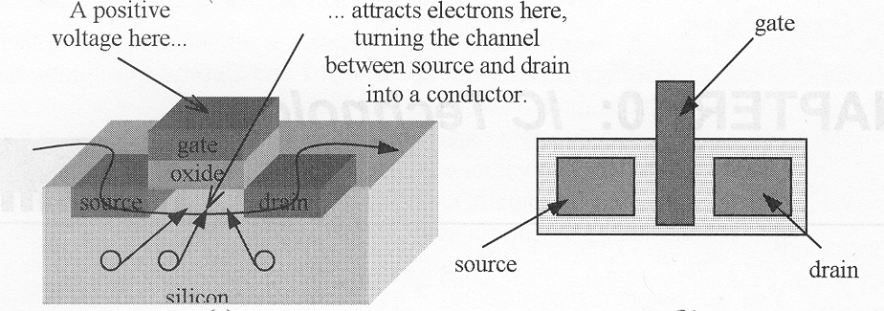
CMOS transistor
Source, Drain
  Diffusion area where electrons can flow
  Can be connected to metal contacts (via’s)
Gate
  Polysilicon area where control voltage is applied
Oxide
  Si O₂ Insulator so the gate voltage can’t leak

Slide 4
End of the Moore’s Law?
Every dimension of the MOSFET has to scale
  (PMOS) Gate oxide has to scale down to
    Increase gate capacitance
    Reduce leakage current from S to D
    Pinch off current from source to drain
  Current gate oxide thickness is about 2.5-3nm
That’s about 25 atoms!!!
gate
IC package
IC
oxide
source
channel
drain
Silicon substrate

Slide 5
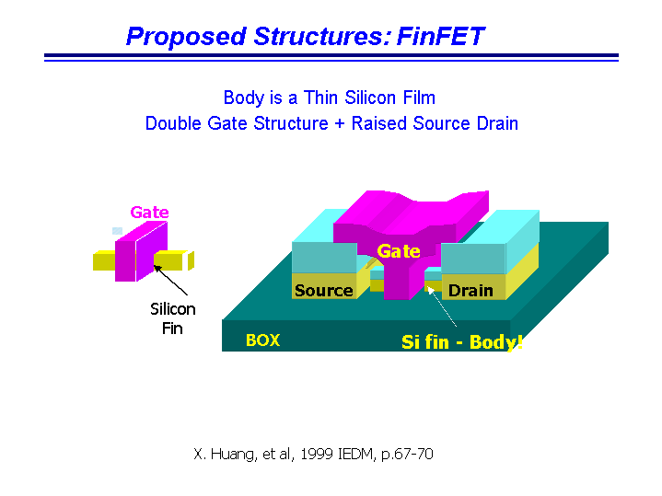

Slide 6
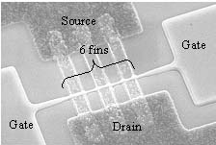
20Ghz +
FinFET has been manufactured to 18nm
  Still acts as a very good transistor
Simulation shown that it can be scaled to 10nm
  Quantum effect start to kick in
    Reduce mobility by ~10%
  Ballistic transport become significant
    Increase current by about ~20%

Slide 7
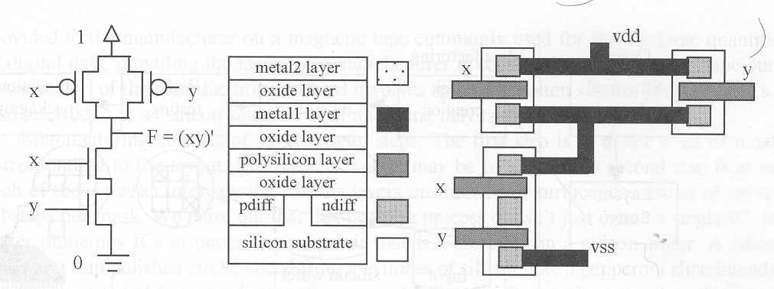
NAND
Metal layers for routing (~10)
PMOS don’t like 0
NMOS don’t like 1
A stick diagram form the basis for mask sets

Slide 8
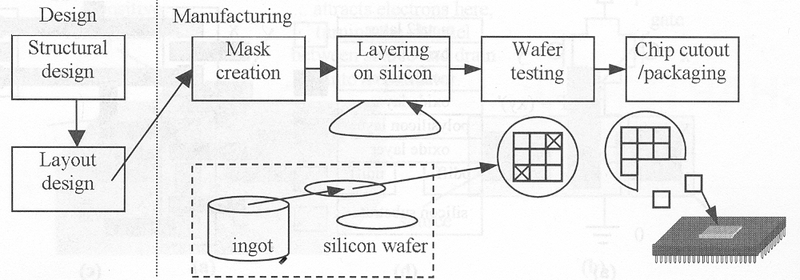
Silicon manufacturing steps
Tape out
  Send design to manufacturing
Spin
  One time through the manufacturing process
Photolithography
  Drawing patterns by using photoresist to form barriers for deposition

Slide 9
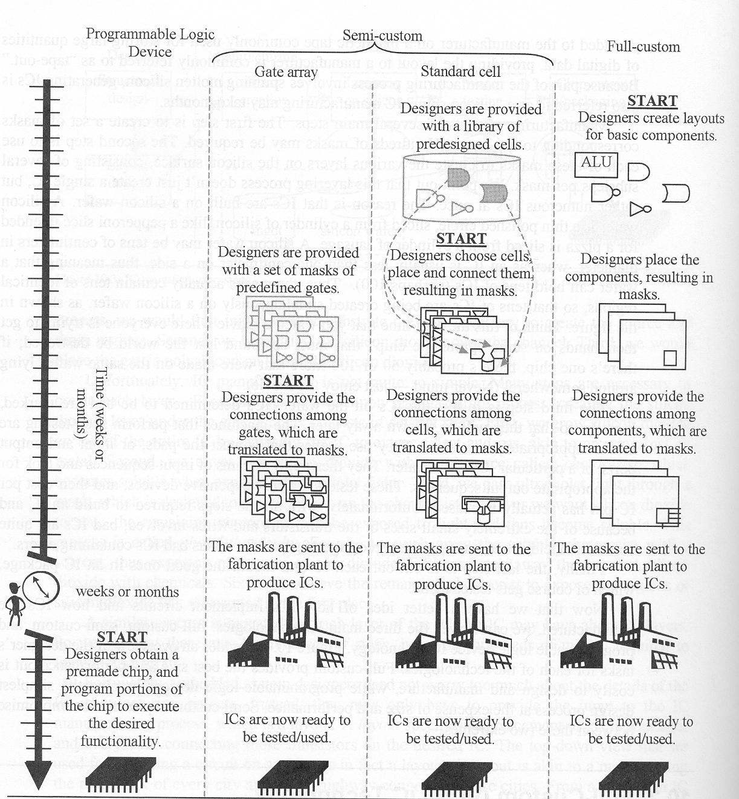
Full Custom
Very Large Scale Integration (VLSI)
Placement
  Place and orient transistors
Routing
  Connect transistors
Sizing
  Make fat, fast wires or thin, slow wires
  May also need to size buffer
Design Rules
  “simple” rules for correct circuit function
    Metal/metal spacing, min poly width…

Slide 10
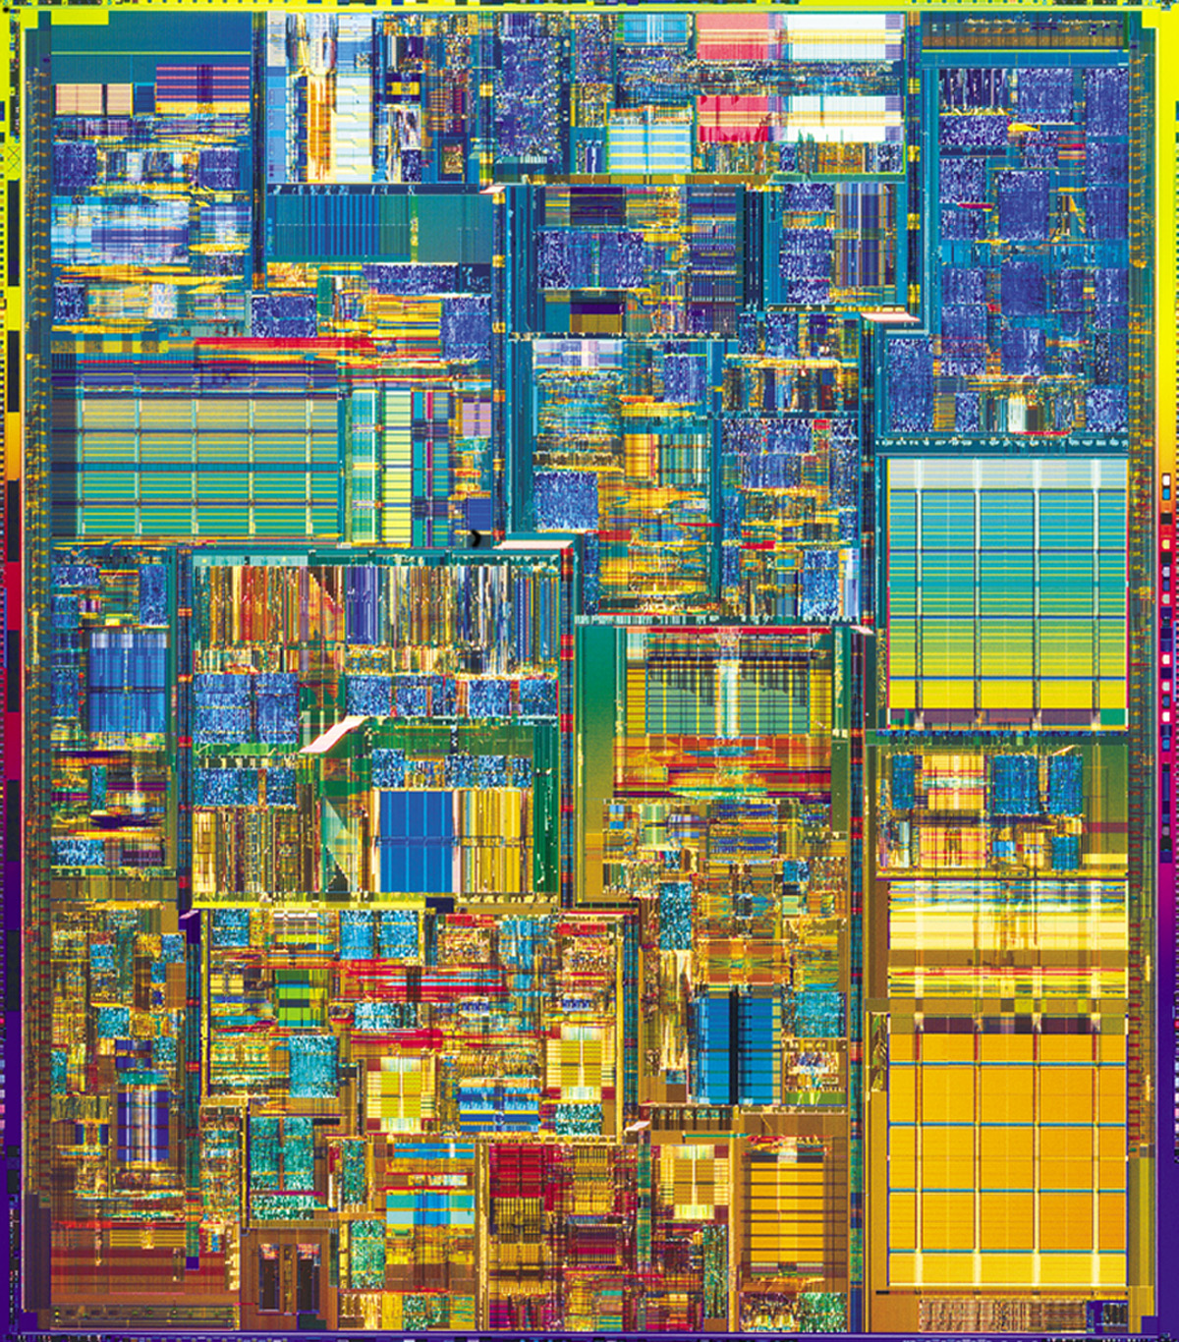
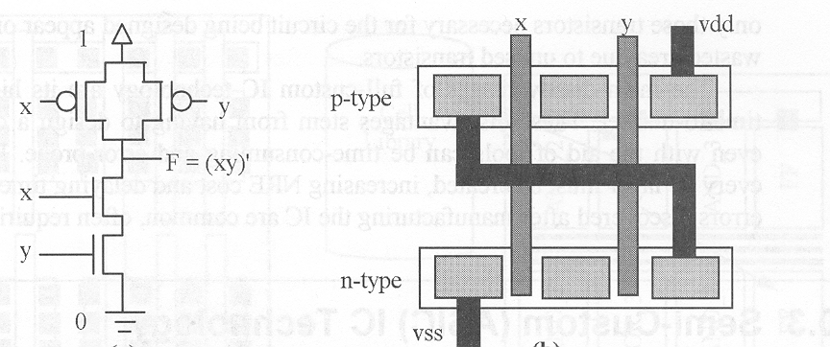
Full Custom
Best size, power, performance
Hand design
  Horrible time-to-market/flexibility/NRE cost…
  Reserve for the most important units in a processor
    ALU, Instruction fetch…
Physical design tools
  Less optimal, but faster…

Slide 11
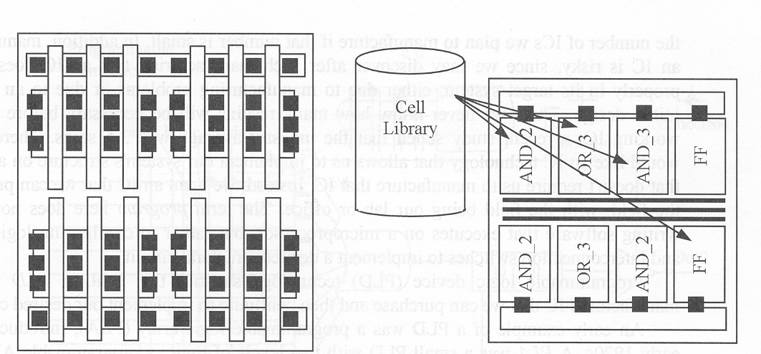
Semi-Custom
Gate Array
  Array of prefabricated gates
  “place” and route
  Higher density, faster time-to-market
  Does not integrate as well with full-custom
Standard Cell
  A library of pre-designed cell
  Place and route
  Lower density, higher complexity
  Integrate great with full-custom

Slide 12
Semi-Custom
Most popular design style
Jack of all trade
  Good
    Power, time-to-market, performance, NRE cost, per-unit cost, area…
Master of none
  Integrate with full custom for critical regions of design

Slide 13
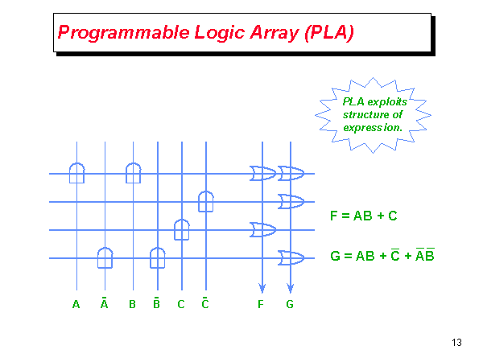

Slide 14
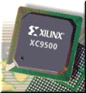
Programmable Logic Device
Programmable Logic Device
  Programmable Logic Array, Programmable Array Logic, Field Programmable Gate Array
All layers already exist
  Designers can purchase an IC
  To implement desired functionality
    Connections on the IC are either created or destroyed to implement
Benefits
  Very low NRE costs
  Great time to market
Drawback
  High unit cost, bad for large volume
  Power
    Except special PLA
  slower
1600 usable gate, 7.5 ns
$7 list price

Slide 15
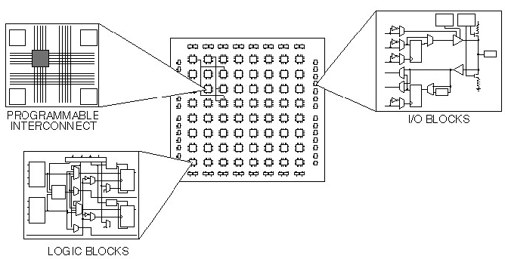
Xilinx FPGA

Slide 16
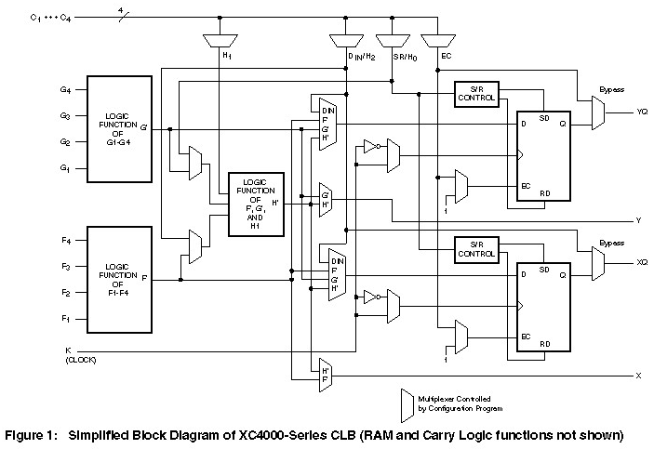
Configurable Logic Block (CLB)

Slide 17
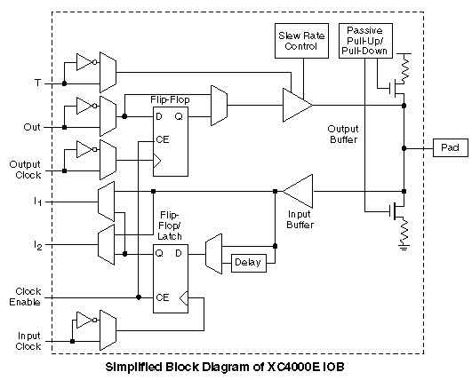
I/O Block

